Slide 1


Slide 2
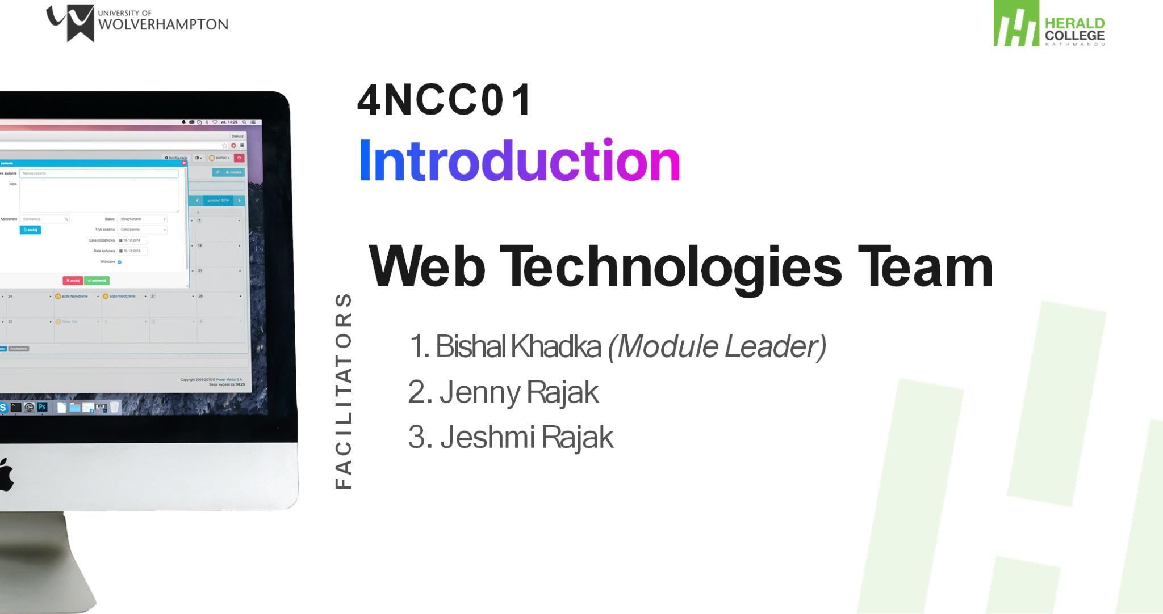

Slide 3
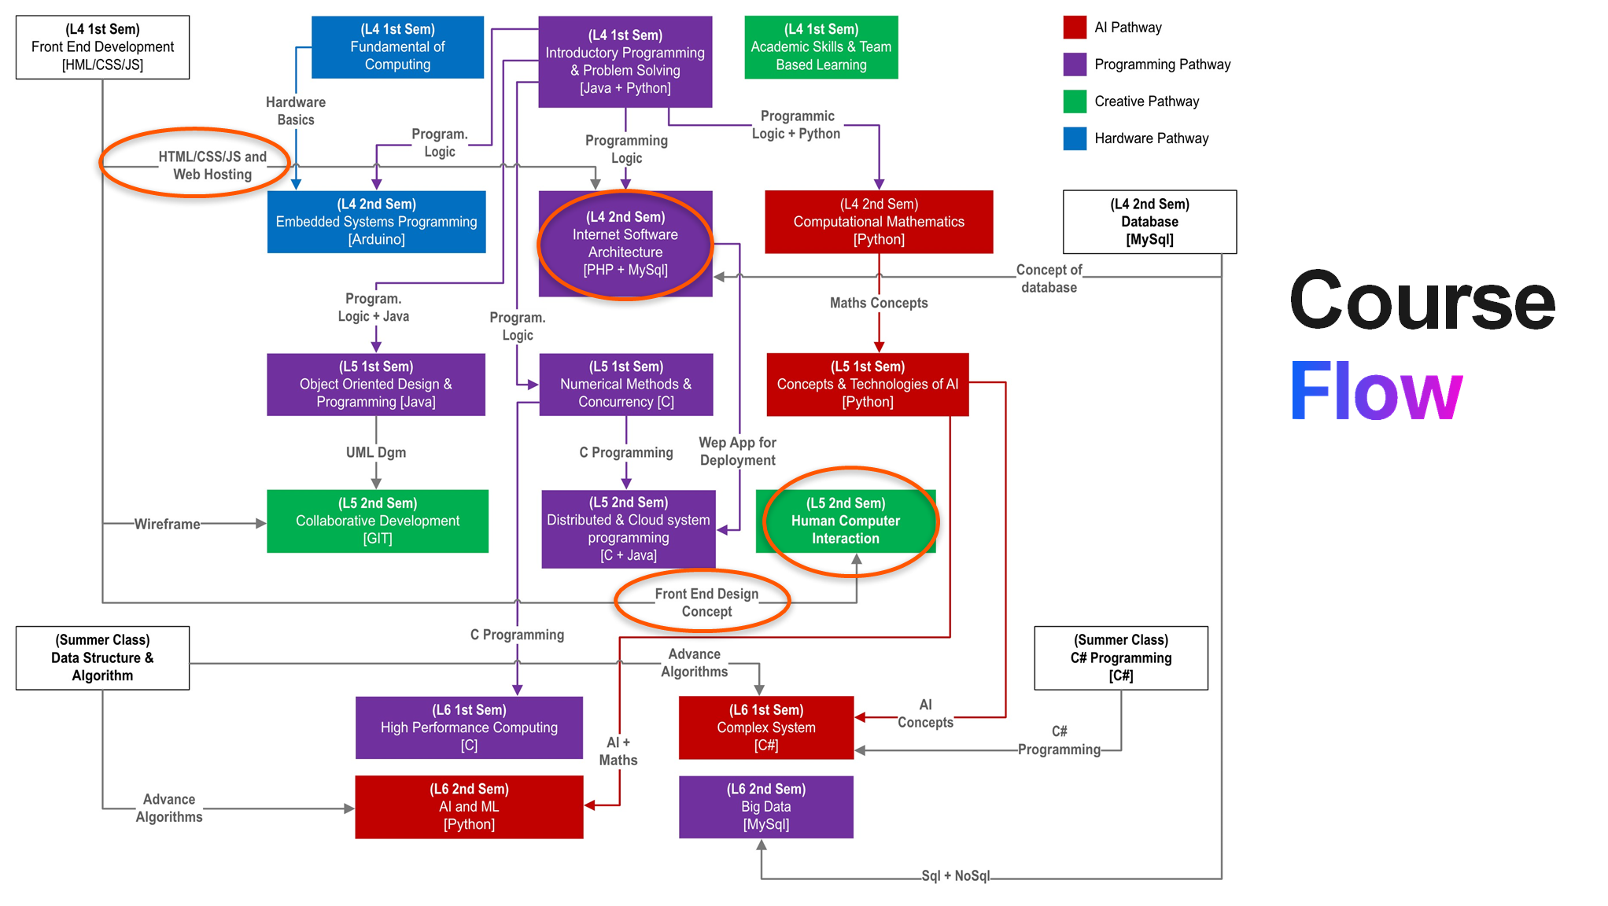
Introduction
Course flow
Introduction to HTML
The Internet
Web Server
Web Browser

Slide 4
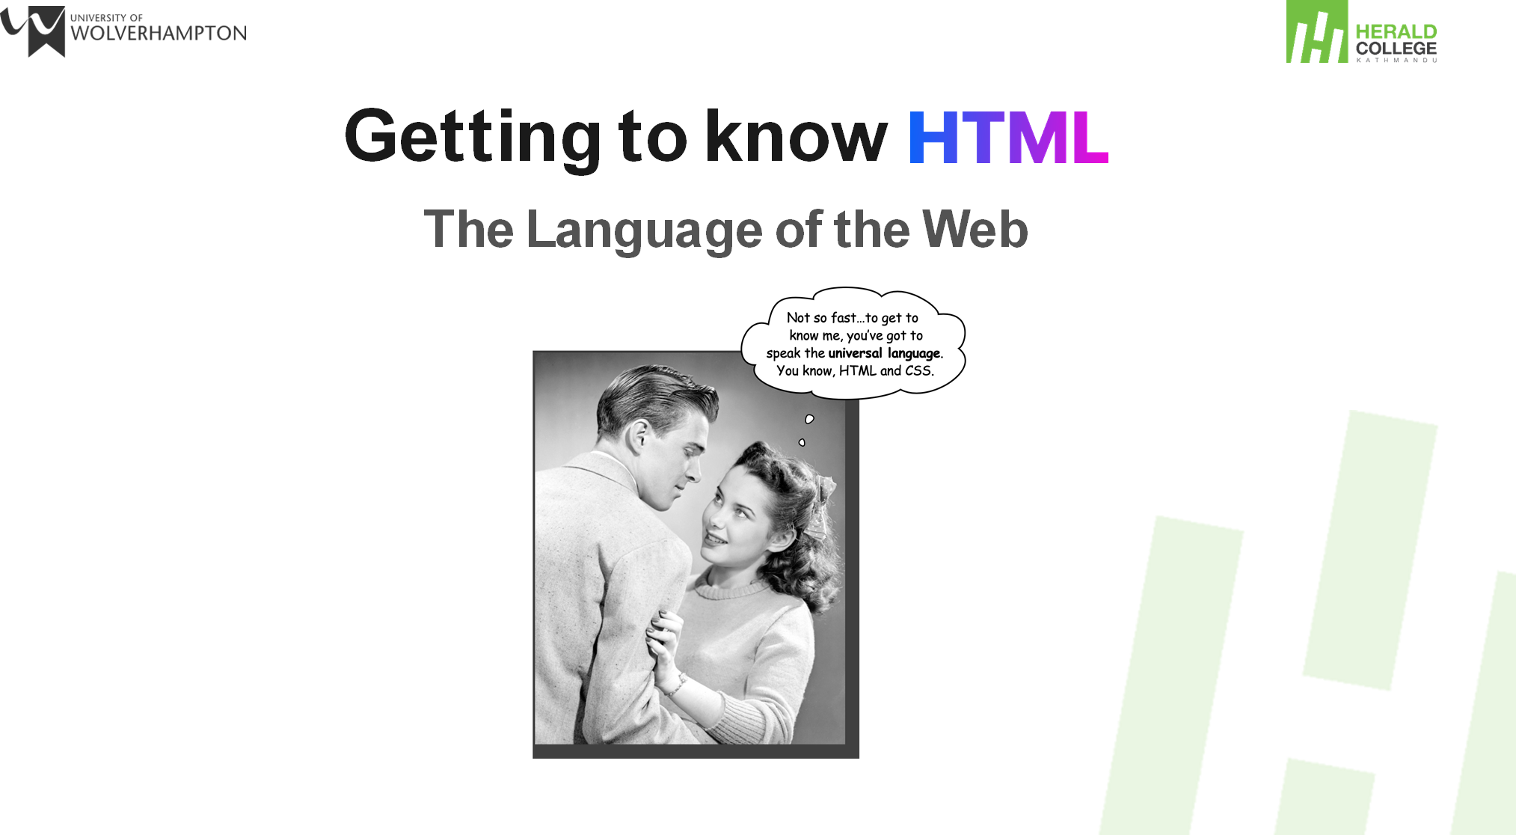
Introduction
Course flow
Introduction to HTML
The Internet
Web Server
Web Browser

Slide 5
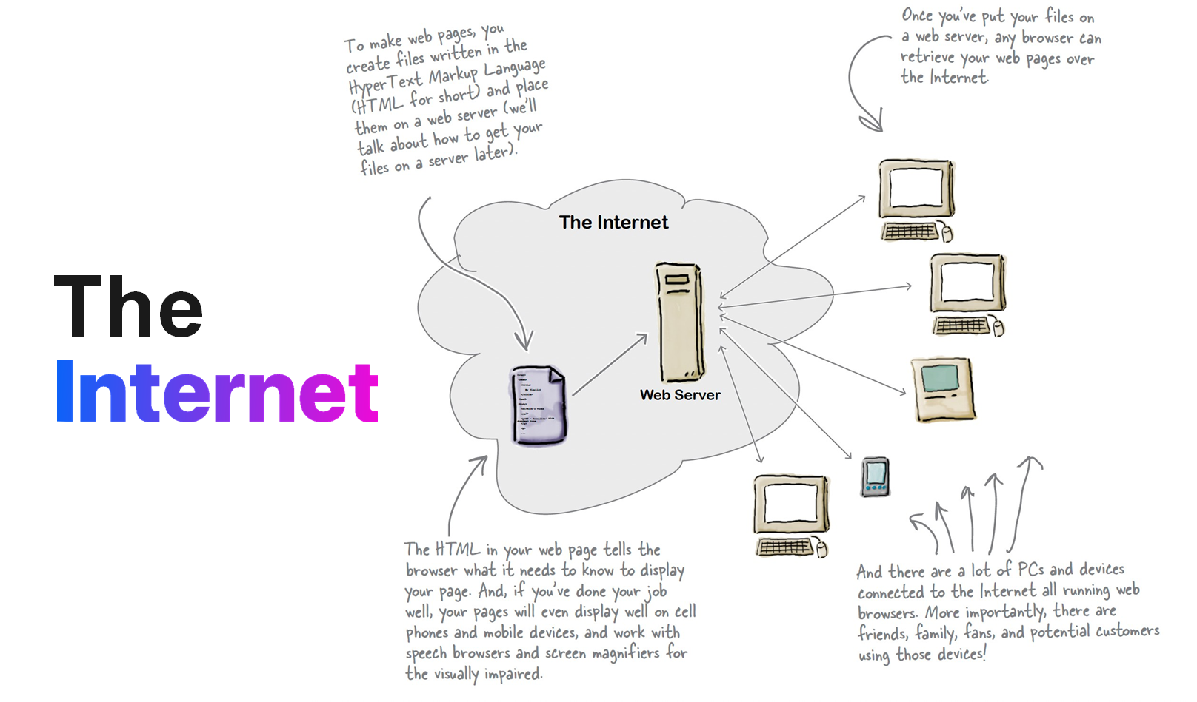
Introduction
Course flow
Introduction to HTML
The Internet
Web Server
Web Browser

Slide 6
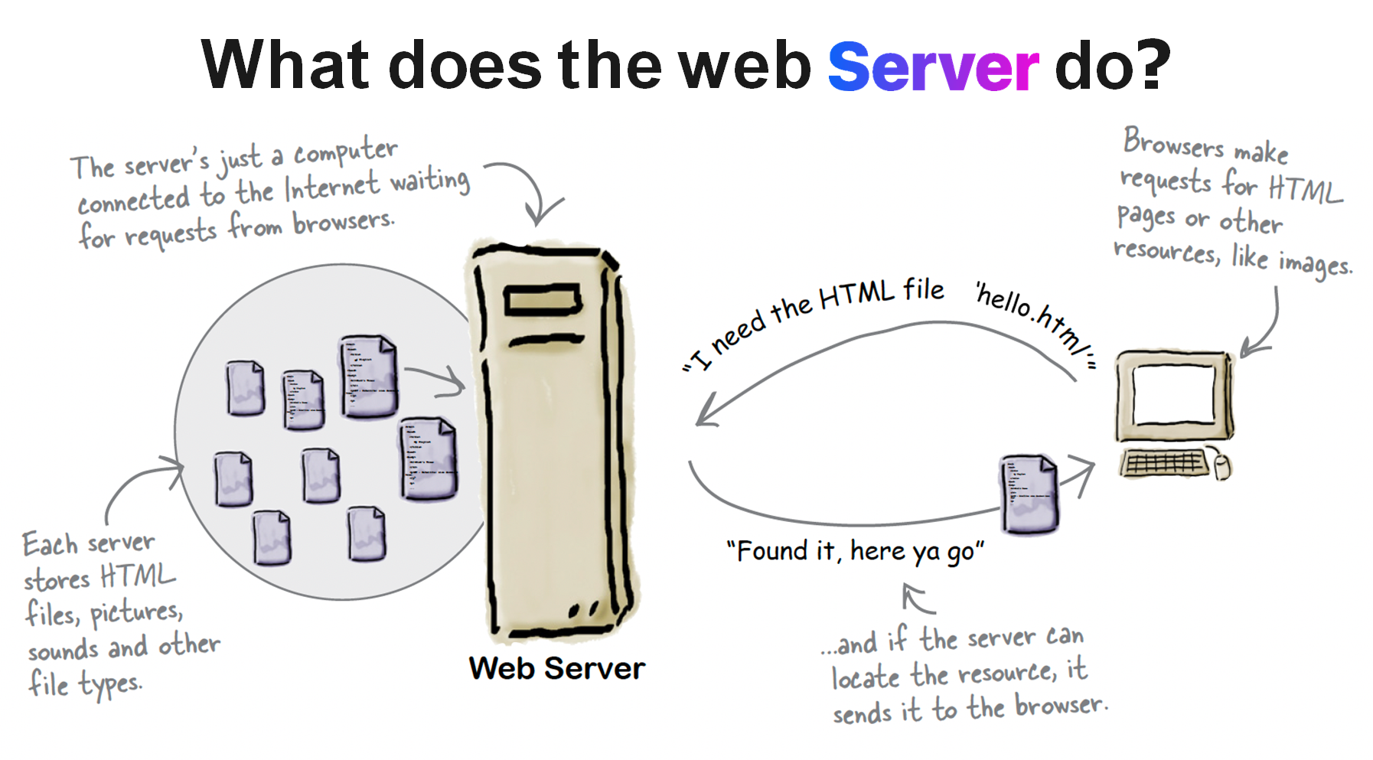
Introduction
Course flow
Introduction to HTML
The Internet
Web Server
Web Browser

Slide 7
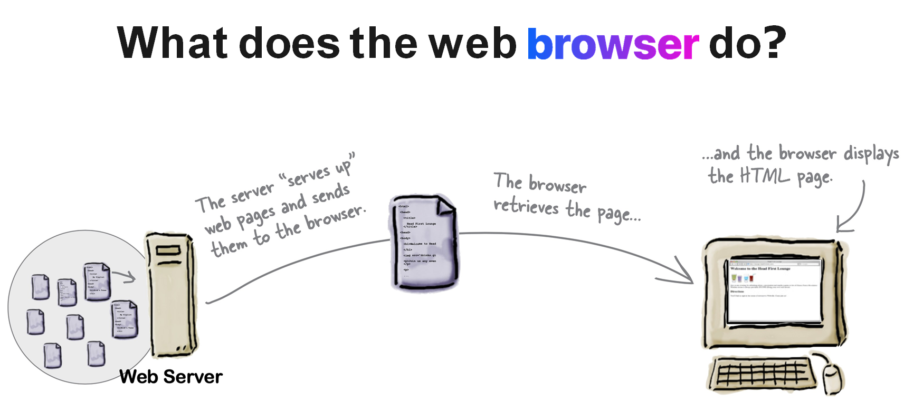
Introduction
Course flow
Introduction to HTML
The Internet
Web Server
Web Browser

Slide 8
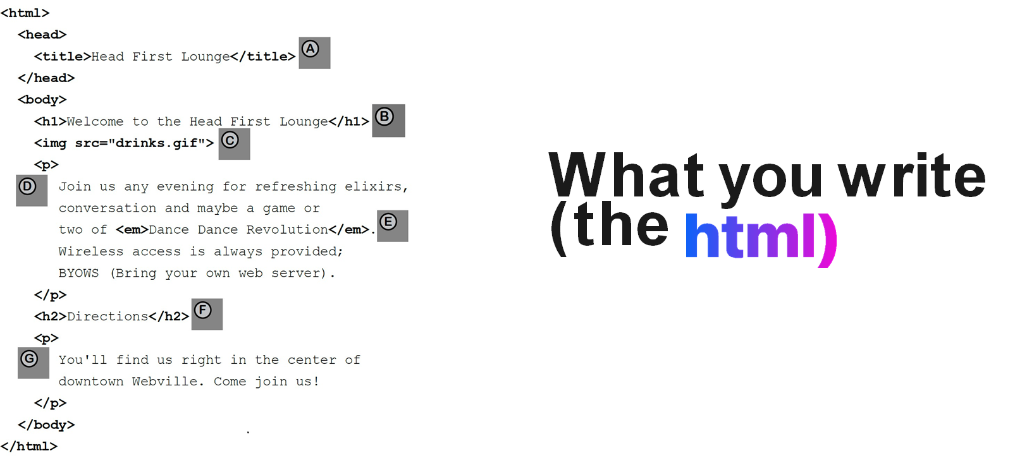
HTML
1. Introduction to HTML
2. How Browser Create
3. Html Complexity
4. What are web page made up of
5. Writing Html Tags
6. Web Page Construction
7. IDE
8. Module Grading

Slide 9
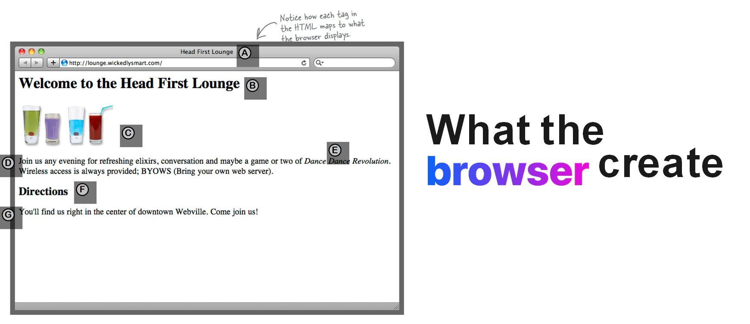
HTML
1. Introduction to HTML
2. How Browser Create
3. Html Complexity
4. What are web page made up of
5. Writing Html Tags
6. Web Page Construction
7. IDE
8. Module Grading

Slide 10
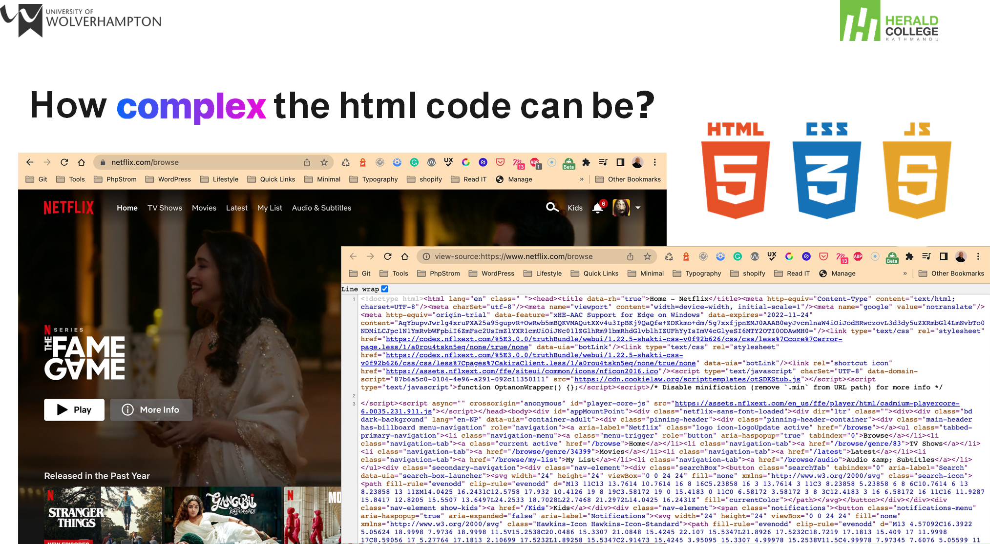
HTML
1. Introduction to HTML
2. How Browser Create
3. Html Complexity
4. What are web page made up of
5. Writing Html Tags
6. Web Page Construction
7. IDE
8. Module Grading

Slide 11
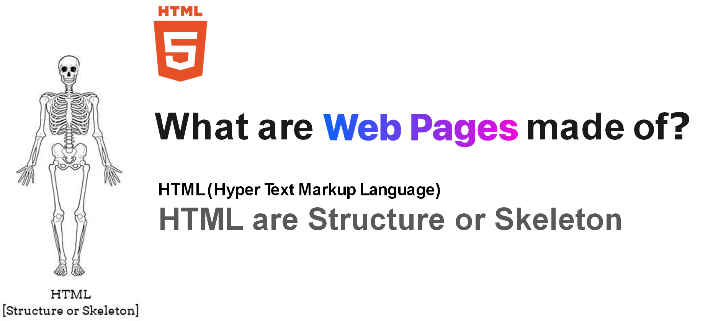
HTML
1. Introduction to HTML
2. How Browser Create
3. Html Complexity
4. What are web page made up of
5. Writing Html Tags
6. Web Page Construction
7. IDE
8. Module Grading

Slide 12
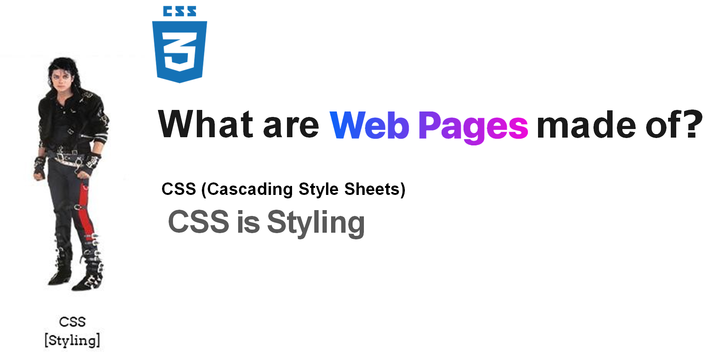
HTML
1. Introduction to HTML
2. How Browser Create
3. Html Complexity
4. What are web page made up of
5. Writing Html Tags
6. Web Page Construction
7. IDE
8. Module Grading

Slide 13

HTML
1. Introduction to HTML
2. How Browser Create
3. Html Complexity
4. What are web page made up of
5. Writing Html Tags
6. Web Page Construction
7. IDE
8. Module Grading

Slide 14
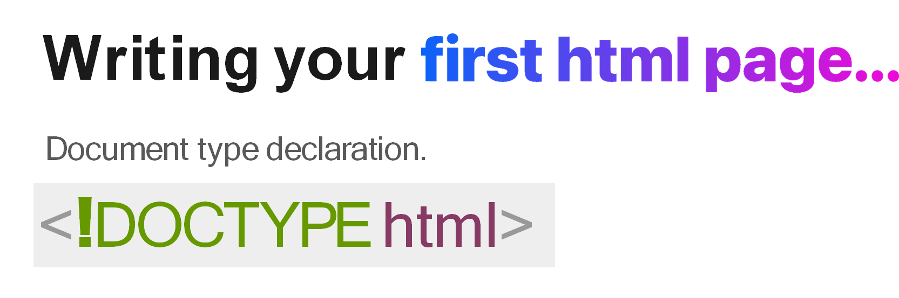
HTML
1. Introduction to HTML
2. How Browser Create
3. Html Complexity
4. What are web page made up of
5. Writing Html Tags
6. Web Page Construction
7. IDE
8. Module Grading

Slide 15
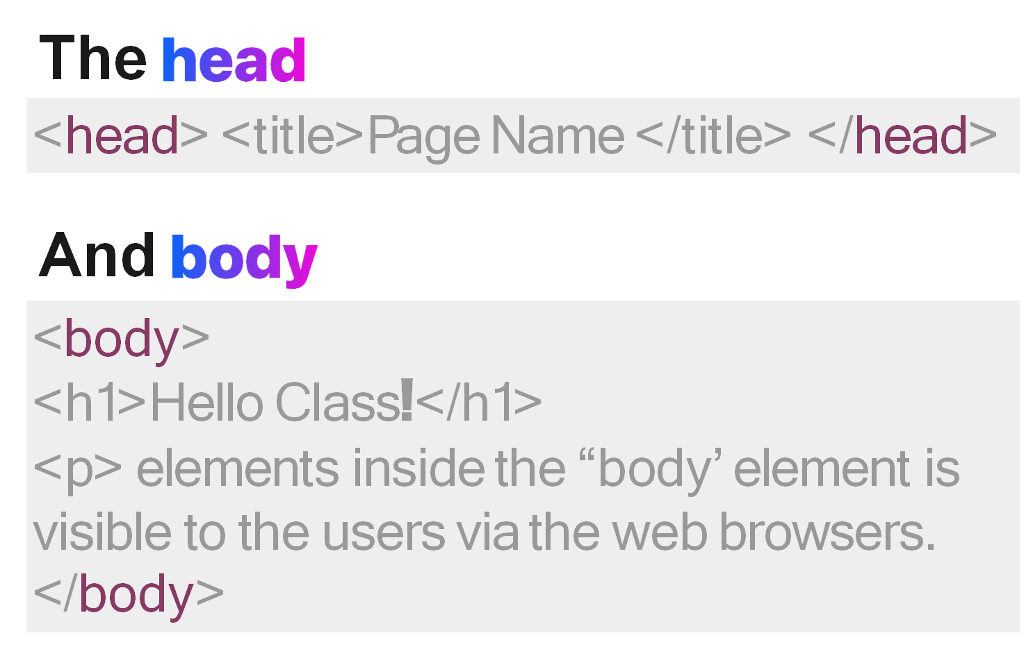
HTML
1. Introduction to HTML
2. How Browser Create
3. Html Complexity
4. What are web page made up of
5. Writing Html Tags
6. Web Page Construction
7. IDE
8. Module Grading

Slide 16
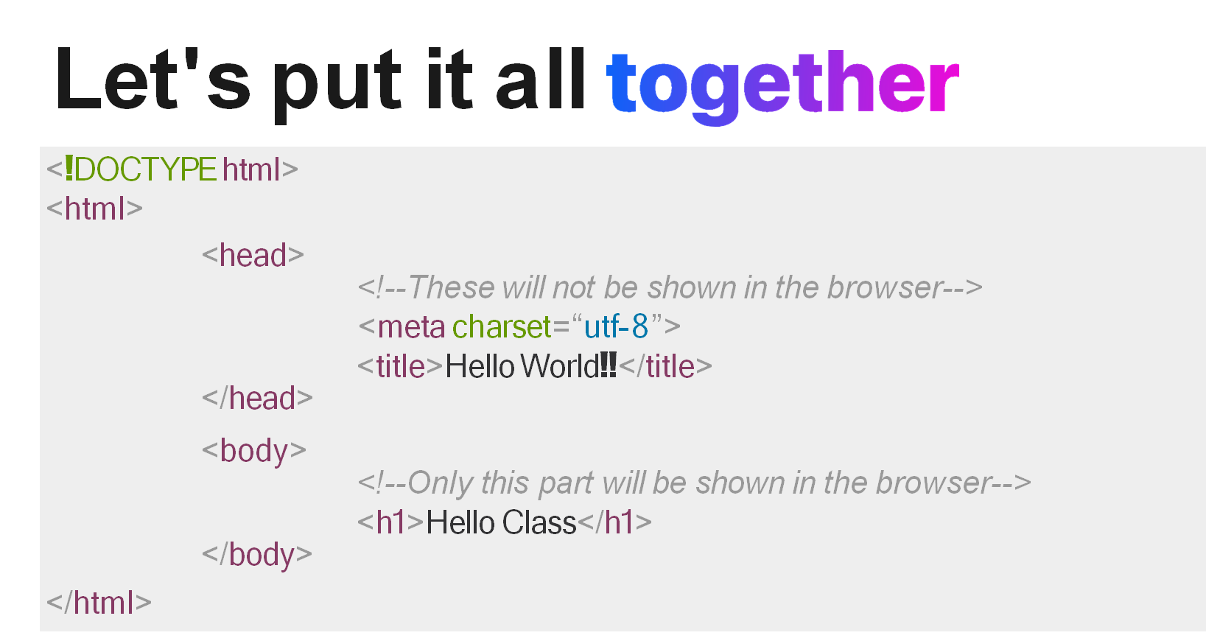
HTML
1. Introduction to HTML
2. How Browser Create
3. Html Complexity
4. What are web page made up of
5. Writing Html Tags
6. Web Page Construction
7. IDE
8. Module Grading

Slide 17
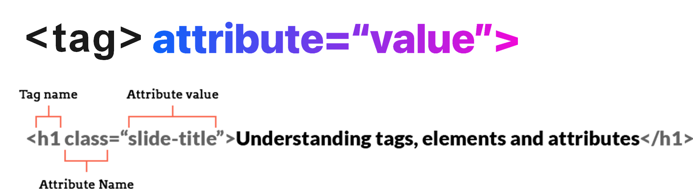
HTML
1. Introduction to HTML
2. How Browser Create
3. Html Complexity
4. What are web page made up of
5. Writing Html Tags
6. Web Page Construction
7. IDE
8. Module Grading

Slide 18
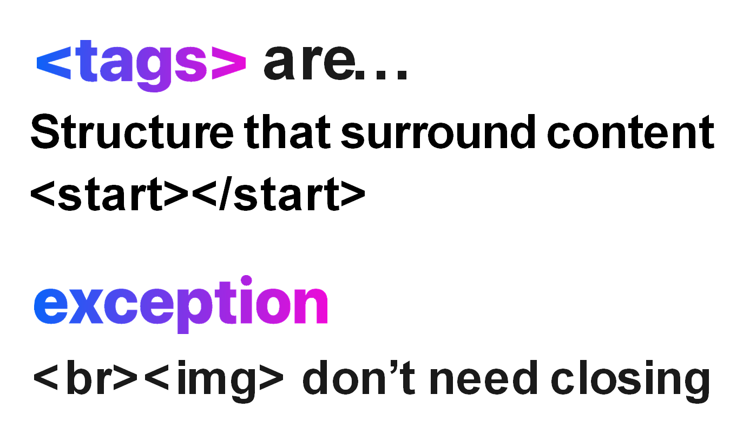
HTML
1. Introduction to HTML
2. How Browser Create
3. Html Complexity
4. What are web page made up of
5. Writing Html Tags
6. Web Page Construction
7. IDE
8. Module Grading

Slide 19
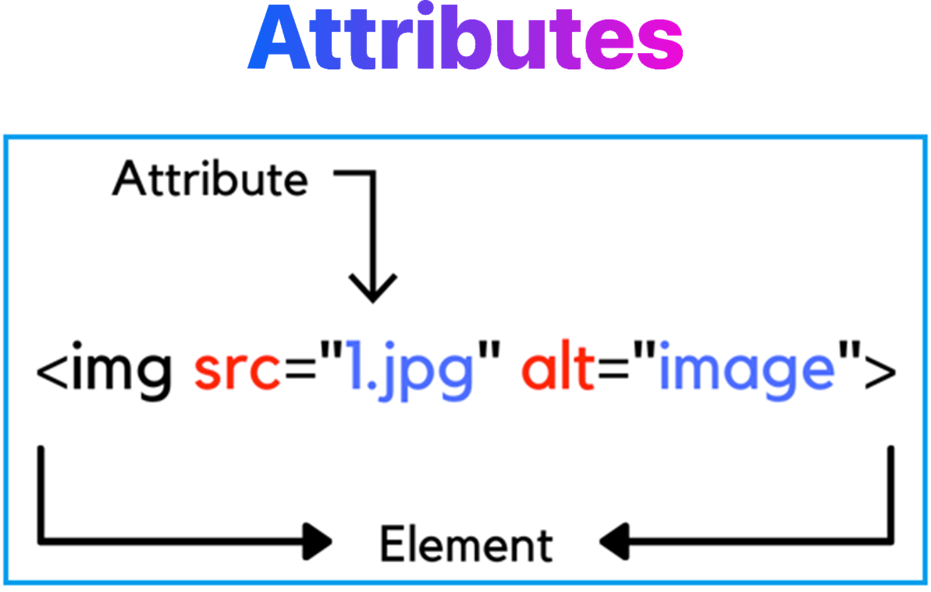
HTML
1. Introduction to HTML
2. How Browser Create
3. Html Complexity
4. What are web page made up of
5. Writing Html Tags
6. Web Page Construction
7. IDE
8. Module Grading

Slide 20

HTML
1. Introduction to HTML
2. How Browser Create
3. Html Complexity
4. What are web page made up of
5. Writing Html Tags
6. Web Page Construction
7. IDE
8. Module Grading

Slide 21
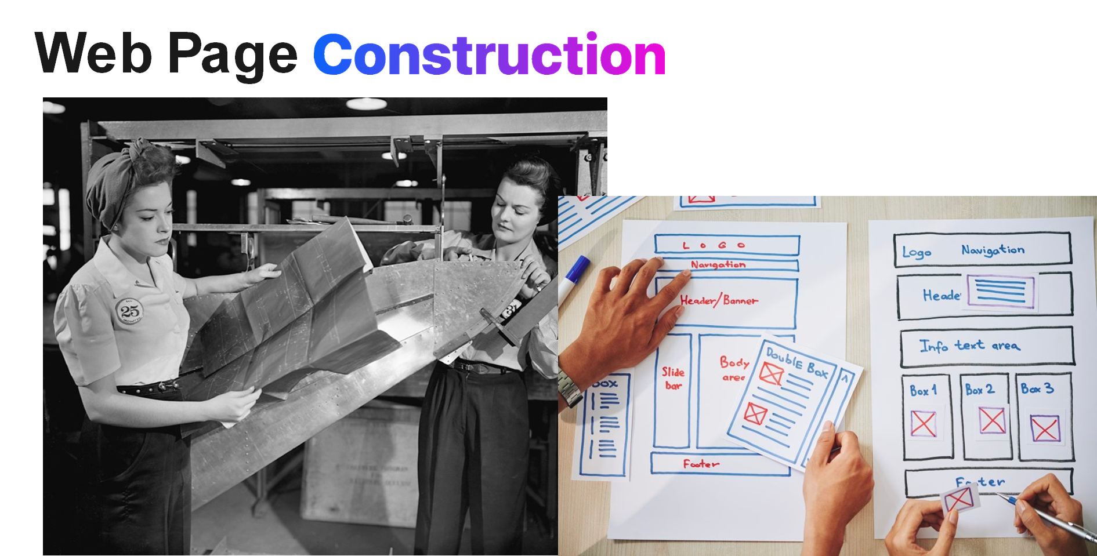
HTML
1. Introduction to HTML
2. How Browser Create
3. Html Complexity
4. What are web page made up of
5. Writing Html Tags
6. Web Page Construction
7. IDE
8. Module Grading

Slide 22
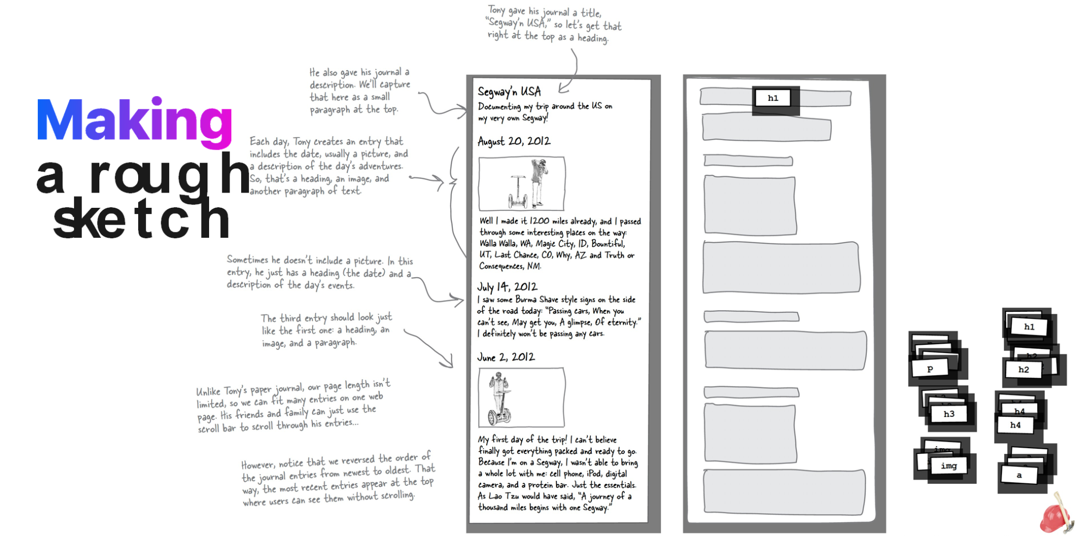
HTML
1. Introduction to HTML
2. How Browser Create
3. Html Complexity
4. What are web page made up of
5. Writing Html Tags
6. Web Page Construction
7. IDE
8. Module Grading

Slide 23
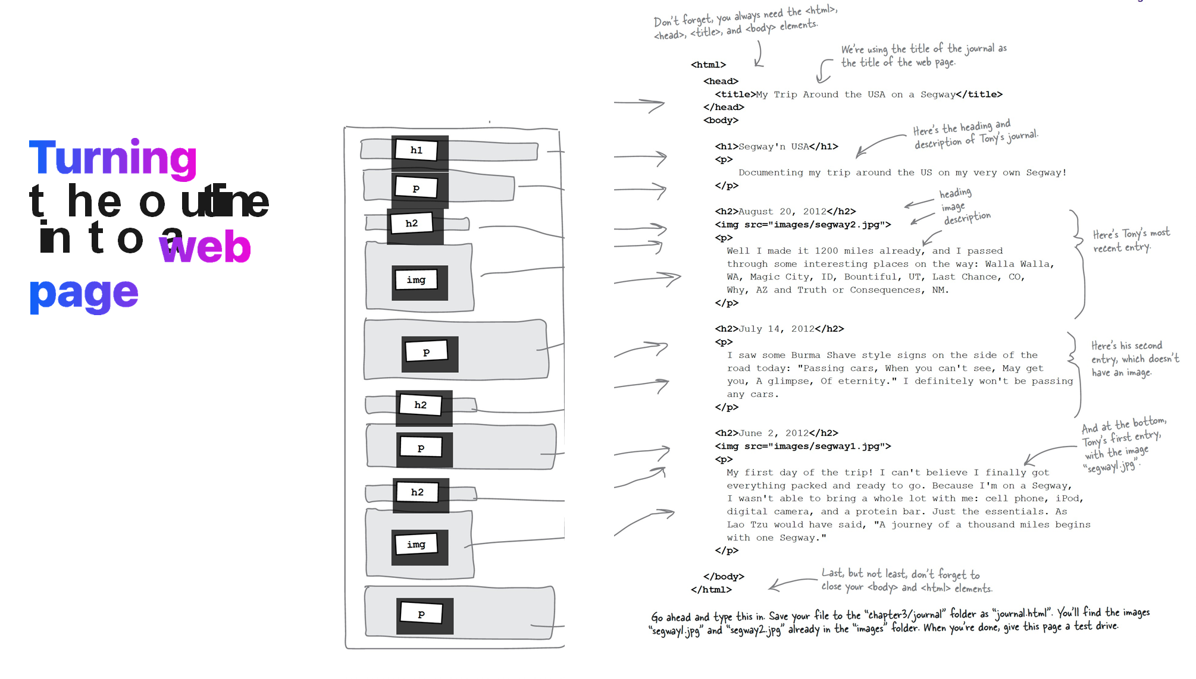
HTML
1. Introduction to HTML
2. How Browser Create
3. Html Complexity
4. What are web page made up of
5. Writing Html Tags
6. Web Page Construction
7. IDE
8. Module Grading

Slide 24

HTML
1. Introduction to HTML
2. How Browser Create
3. Html Complexity
4. What are web page made up of
5. Writing Html Tags
6. Web Page Construction
7. IDE
8. Module Grading

Slide 25
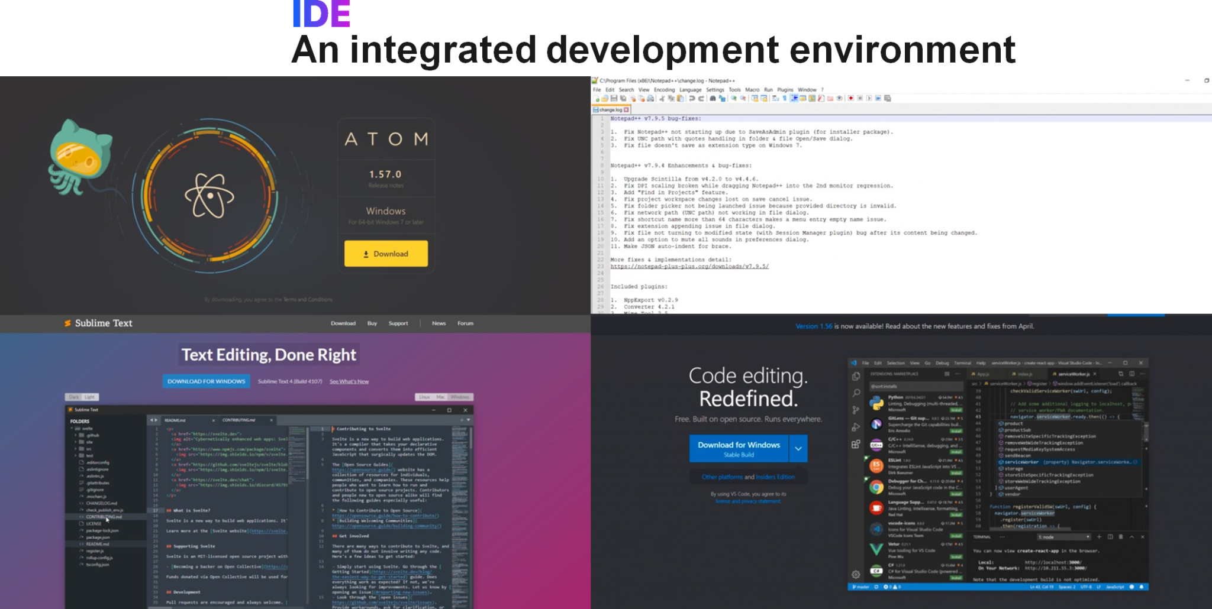
HTML
1. Introduction to HTML
2. How Browser Create
3. Html Complexity
4. What are web page made up of
5. Writing Html Tags
6. Web Page Construction
7. IDE
8. Module Grading

Slide 26
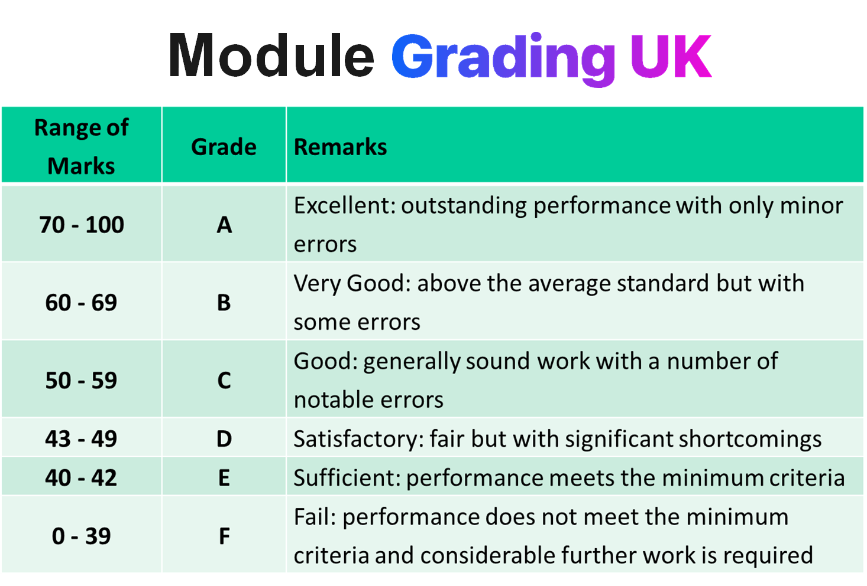
HTML
1. Introduction to HTML
2. How Browser Create
3. Html Complexity
4. What are web page made up of
5. Writing Html Tags
6. Web Page Construction
7. IDE
8. Module Grading

Slide 27
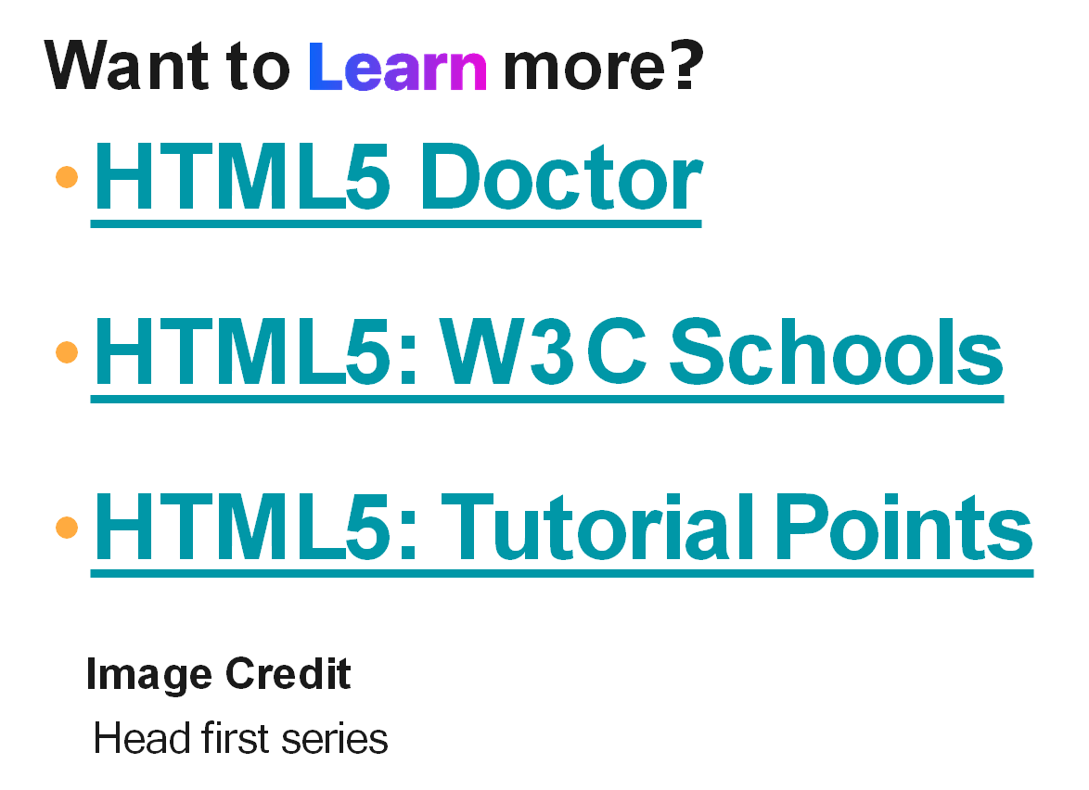
Learn More

